Slide 1
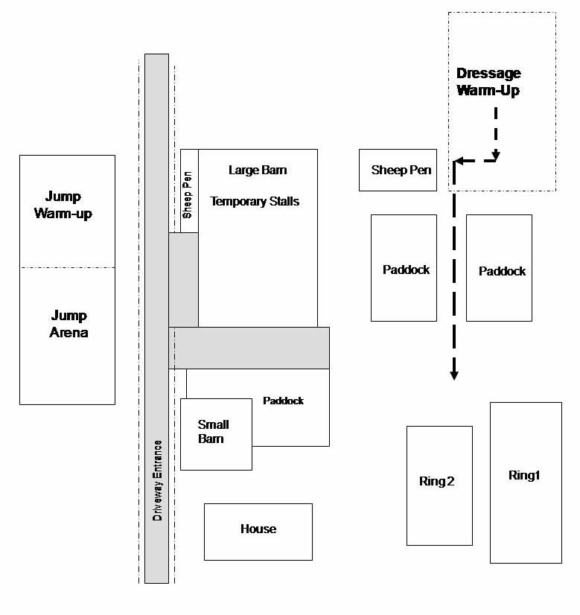
Cross Country Course
Cross Country Course
Cross Country Course
Cross Country Course
Cross Country Course
Cross Country Course

